Slide 1

Results from initial consultation on a St Andrews Local Place Plan

Slide 2
Key stats
Survey ran from 6 June until 13 July 2023
Consultation:
  Morrisons supermarket
    Friday 16 June (12-5)
    Sunday 18 June (10-4)
    Saturday 24 June (10-4)
  Preservation Trust's Hidden Gardens
    Sunday 25 June
  Bandstand opening concert
    Sunday 2 July (2-4)
  Harbour Trust Gala Day
    Saturday 8 July (11-3)
515 responses in total, both paper and online

Slide 3
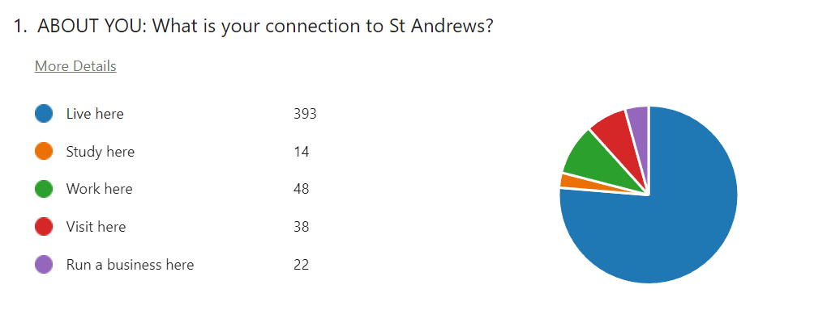
Respondents

Slide 4
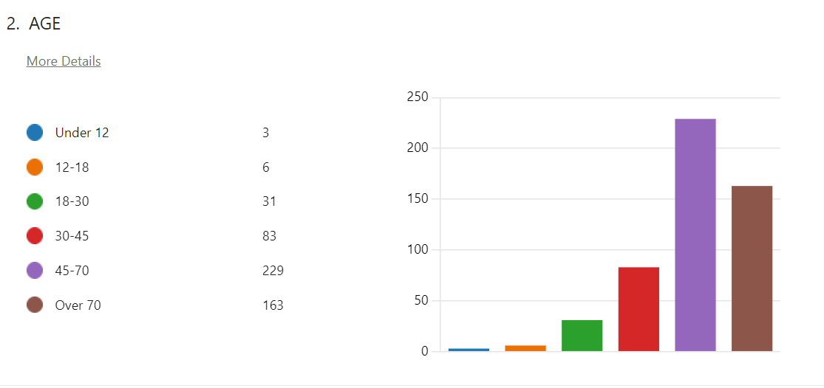
Respondents

Slide 5
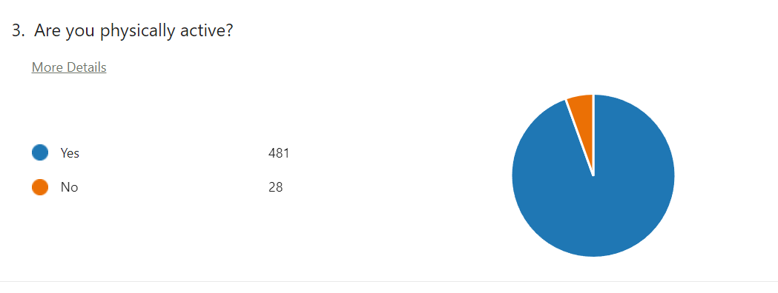
Respondents

Slide 6
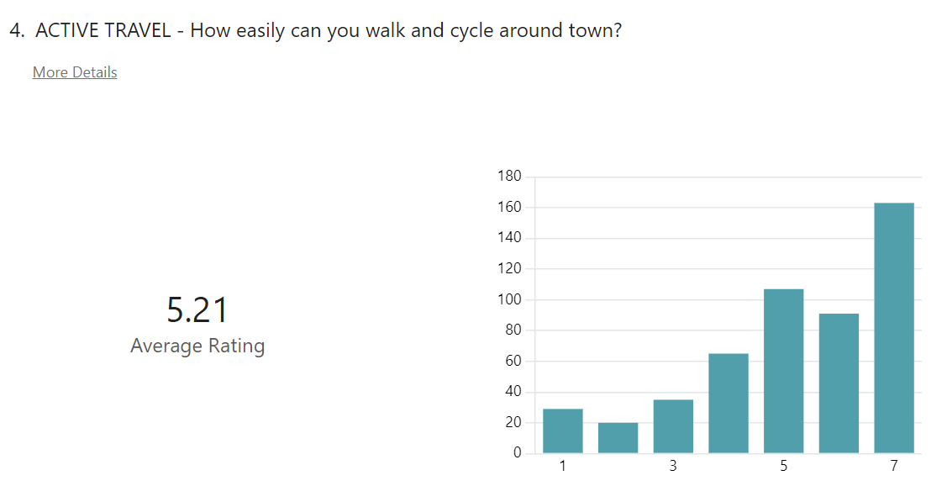
Ratings

Slide 7
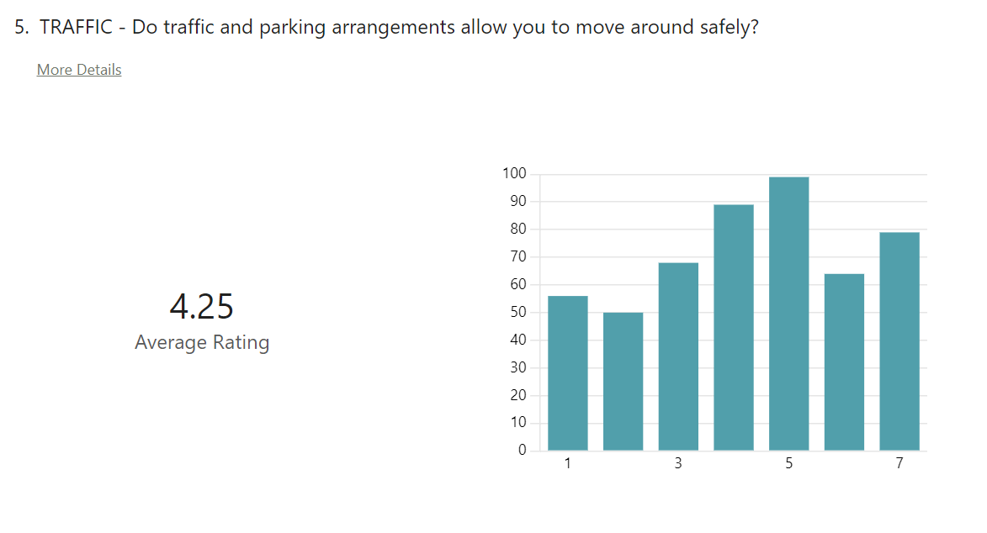
Ratings

Slide 8
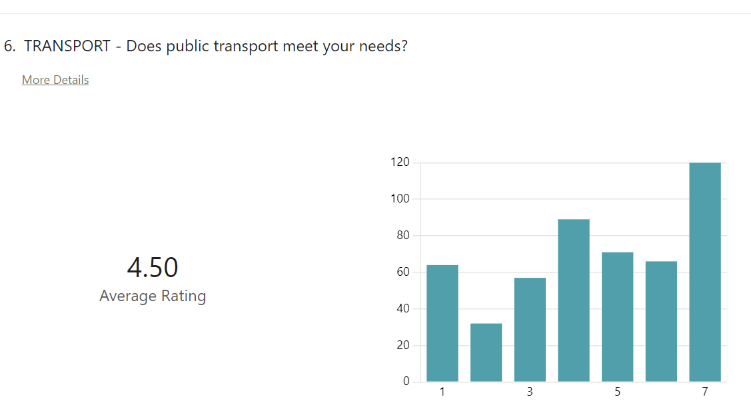
Ratings

Slide 9
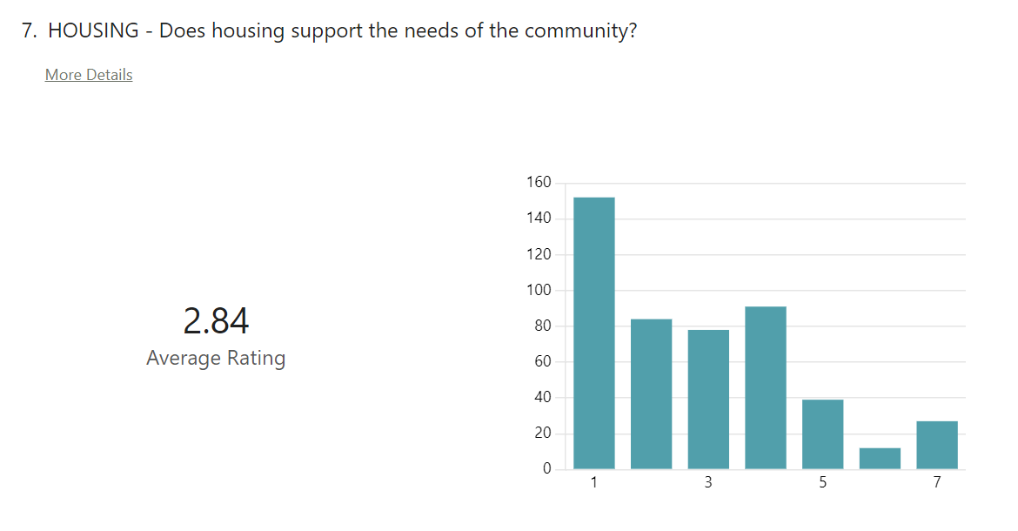
Ratings

Slide 10
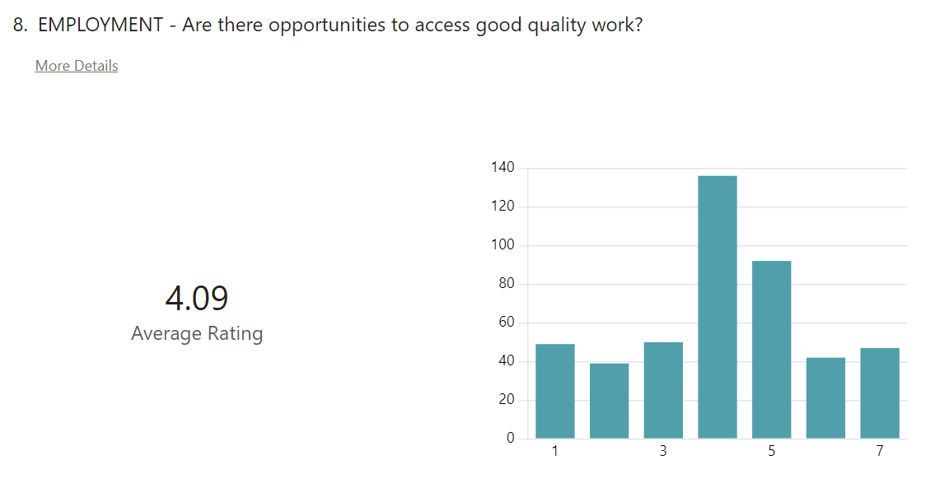
Ratings

Slide 11
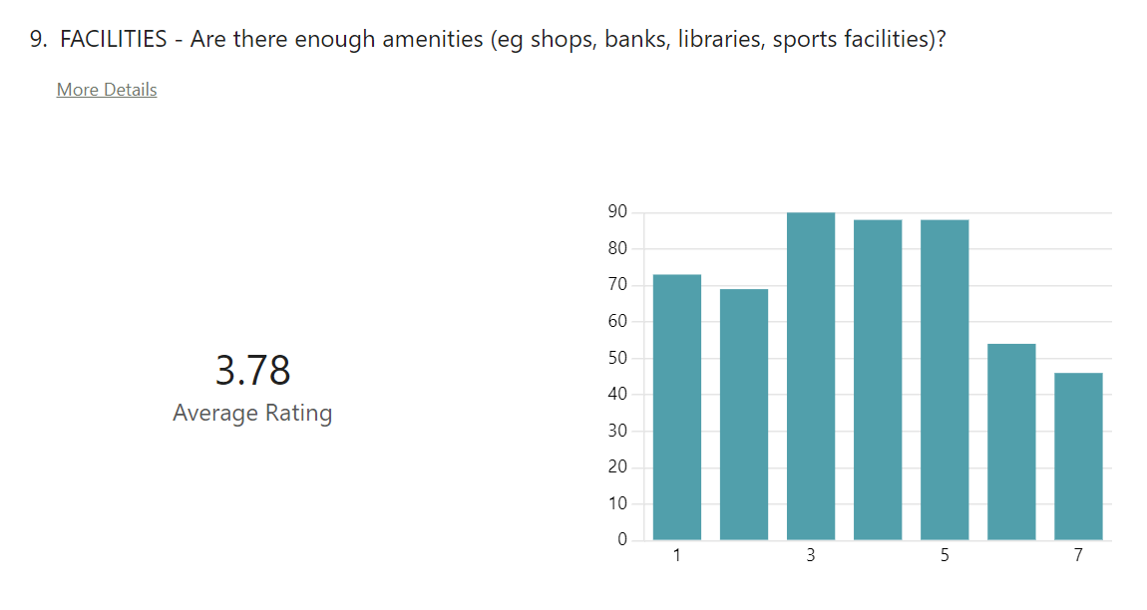
Ratings

Slide 12
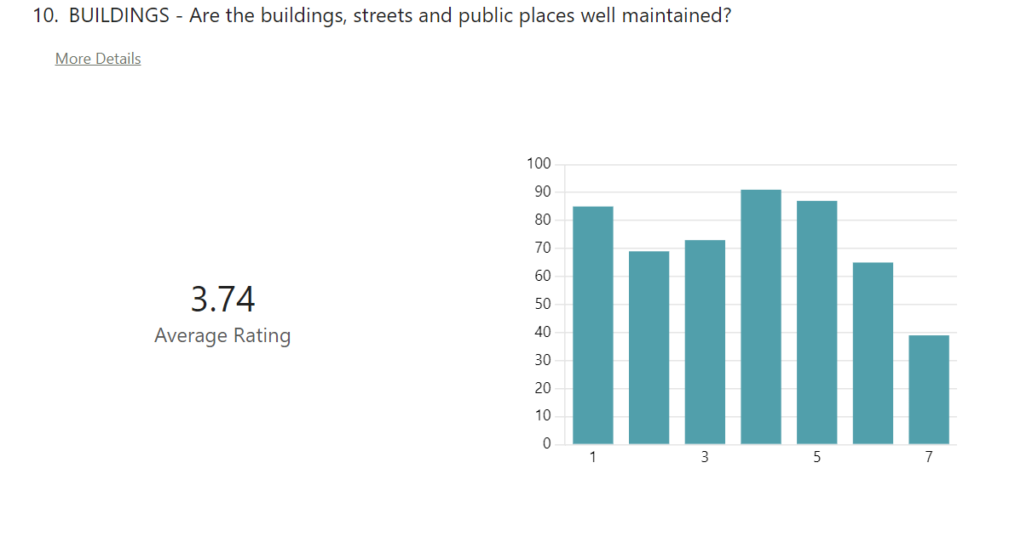
Ratings

Slide 13
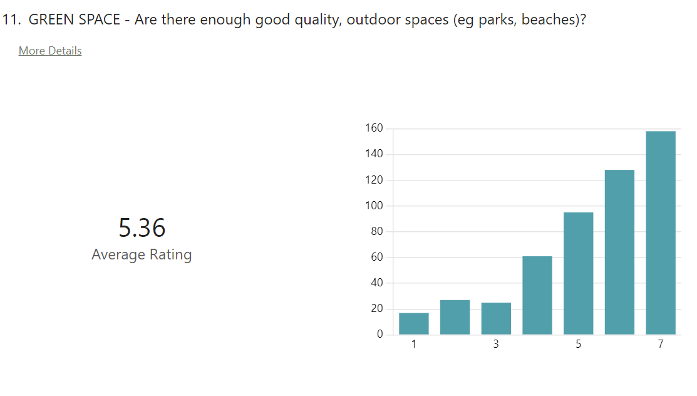
Ratings

Slide 14
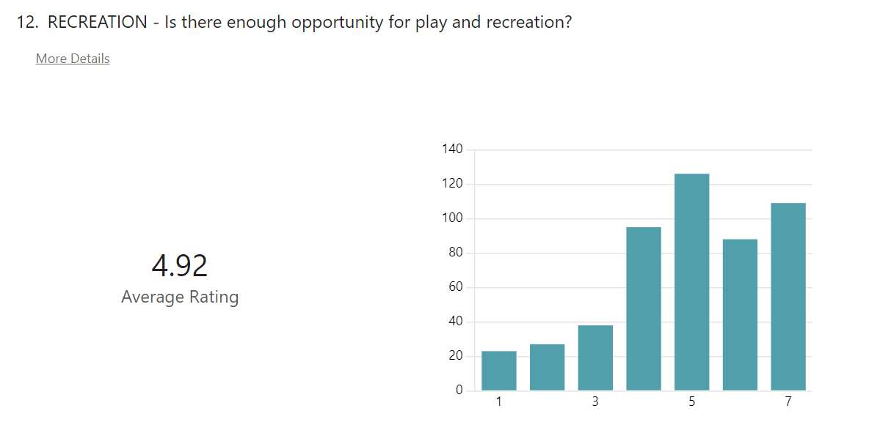
Ratings

Slide 15
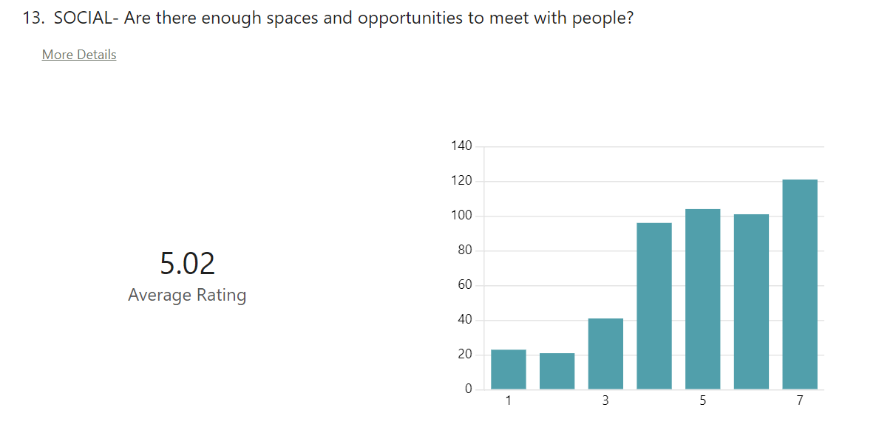
Ratings

Slide 16
Overall Ratings

Slide 18
Topic | Example Comments
More play areas/facilities for children/young people | Children's playgrounds- several need urgent replacement- several are derelict and unsafe- lade braes, near bogward road. There need to be better facilities for children at the beaches especially the West Sands
More accessible amenities, dentists, community spaces, library, theatre, banks, post office | More shops/cafes in residential areas Insufficient support to local services such as road repair, litter control, museums, library, walks, harbour, craigtoun park Ensure the town is supported - schools, doctors, supermarkets, traffic, are all grown to meet the needs of the influx of people from all the new houses going up
Better housing | Existing residents do not like house building but people need to live in warm, dry and light homes that meet their needs.
Fewer students | less students in local housing driving others away from town
More outdoor café seating | I’m enjoying the outside cafes and bars it gives the town a continental feel.
More affordable housing | Cheaper housing for young adults who have grown up in town who work in the town to buy and stay in the town.
More safer cycleways | Sustainable active travel options- shifting St Andrews away from its focus on cars, and onto people.
Town centre pedestrianisation | Pedestrian zone on south street should be progressed. External areas for hospitality expanded. Pop up street markets to encourage people to dwell longer. Market Street must be pedestrianised - it is appalling at present.

Slide 19
Topic | Example Comments
Better leisure facilities | More community use of university facilities and buildings. This should include free or minimum payment to use facilities such as the Byre Theatre, Younger Hall etc Leisure facilities for pre teens, better opening hours and activities at leisure centre Outside adult gym equipment or more locations. Council have taken it from East Sands
More day-to-day, local, independent shops (lower business rates) | Better quality independent shops and shopping experience like in Broughty Ferry. Better shops - but not tourist ones or gift shops Barely do I use the town centre as there is no children's clothes or shoe shops here anymore and no local business
Cleaner/better maintained streets/gull mess | The town centre paving is a disgrace, the type of slabs used in most of South St and all of Market St, hold on to any spills, debris, tree sap and bird excrement and are dangerously slippy in the winter months. The water gets in behind them and they are uneven through the rainy months. The slabs really need to be replaced to match those in the east end ( Baker Lane to Janettas ) which clean up after each shower of rain and are not slippy.
Better public conveniences | Public toilets at the harbour smartened up and readily available to the public. Improved toilet facilities - the ones by the library are "acceptable" but others, such as east sands, harbour etc are really not.
Less traffic / better parking enforcement/Park and ride | East sands beach needs parking sorted as car park an eyesore Park and ride system put in place and no cars in Market Street, part of South St and part of North Street. Just being able to drive around perimeter. Pedestrianisation of both South and market Street with restricted time access for deliveries and refuse collection. A suitable multi story can be built at petheram bridge.

Slide 20
Topic | Example Comments
Fewer short-term lets/HMOs/Airbnbs | Get rid of or severely curtail AirB&B type (very short let) rentals that suck housing out of the local market Less HMO/airbnb/holiday let properties
Better, cheaper bus/rail service | Direct bus to Dundee from Bogward being reinstated More buses round town for locals. Ie reinstate buses round kilrmont area especially are there are more homes just been built in this area.
Clearer pavements for pedestrians | More benches to sit on in town centre Fewer dining/coffee/drinks areas outdoors - only those who block the pavement, with no space to walk through, forcing pedestrians on to the road. Wider Pavements on bell street and church street A pedestrian area in the centre, better access for disabled
More parking | Permit a short period free parking for residents to briefly access central businesses (banks/post office etc). Restore parking spaces in the centre of town. Improve the traffic flow so that there are more exits from the town centre eg traffic should flow south down Queen’s Gdns rather than north.
Allotments/growing spaces | Set up some allotments so that people can grow plants and communicate there.
Employment for unskilled workers | It would be great if there were more opportunities for quality employment for unskilled workers - a lot of the hospitality work goes to the students.

Slide 21
Proposals
Category | Proposal
Children/young people | More children’s play areas (eg Bogward, Learmonth Place)
 | Outdoor soft play space near West Sands
 | Dog-free areas on beaches
 | Hub for teenagers
 | A family indoor hub/ play / cafe / activity centre
Amenities | More dentists, GPs
 | More university buildings for community use
 | Byre to be maintained as a community asset
 | Banking hub
 | More care homes for elderly
 | More activities for locals
 | More town and gown events

Slide 22
Category | Proposal
Housing | All new housing should be 50% to rent
 | New housing no larger than 3 beds
 | Introduce community heating/power systems
 | Control rent costs
Active travel | Cycle lanes on main routes into St Andrews from surrounding villages
 | More cycle parking
 | Bridge over A91 at Petherum
 | Cycle trails
 | Dedicated bike lanes in North Street
 | Coastal cycle path
 | Safer crossing of North Street
 | A walkway/pavement from Strathkinness to St Andrews down the High Road
Pedestrianisation | Pedestrianisation of market street / South Street / College Street
 | Pedestrianisation during summer months
 | More 'market' space in the town centre
 | No on-street parking in town centre

Slide 23
Category | Proposal
Leisure facilities | Beach huts for permanent residents to rent
 | Outside adult gym equipment or gym in town
 | More community sports facilities (football, basketball, tennis)
 | Longer opening times at East Sands
 | Links Trust lower season ticket price for locals
 | Better management of West Sands
 | Poster sites to advertise community events
 | Increased library hours
Shops | More cafes/shops in residential areas (eg St Andrews West?)
 | Lower rates to encourage independent shops
Streets | More benches in town centre
 | Investment in St Andrews cathedral
 | Clean out gutters in Market Street and Crails Lane
 | Seagull culling
 | Town electricity/sewage infrastructure renewed

Slide 24
Category | Proposal
Streets etc | Commercial bins removed from South Street
 | Shops should clean own pavements/frontage
 | Collect town centre rubbish with smaller vehicle daily
 | Control shop frontages
 | Removal of homeless people
 | Tidy up all the dejected bikes so people can use the cycle bays
WCs | Better public conveniences at Harbour and East Sands, open longer
Traffic/parking | Park and ride / town shuttle
 | Petheram Bridge multi-storey car park
 | One-way South Street
 | Remove heavy traffic from town centre (eg Bridge Street, City Road, North Street)
 | Town traffic/circulation plan
 | Stop Hope Street being a rat run
 | Traffic calming measures particularly on North St, Market St, South St, Bell St, Church St and Golf Place onto West Sands Rd.
 | Improved exit from golf courses/west sands beach onto main road at Auchterlonies

Slide 25
Category | Proposal
Traffic/parking etc | Restrict mobile homes parking at East Sands
 | Make parts of Doubledykes Rd and Argyle St one way
 | Make exit onto Queens Gardens from South Street.
 | 20mph speed limit across St Andrews
 | Cars prohibited from parking on grass in Abbey Street
 | Forbid cars parking on cycle lanes
 | Flash signs on one-way West Port
Short term lets | Tourist tax
 | Restrict short-term lets
Public transport | St Andrews train station
 | More off-road bus laybys to improve traffic flow (eg near Morrisons)
 | Better bus service from villages into town
 | Better bus service around town / electric town buses
 | More night buses
 | Direct bus connection to Edinburgh airport
 | Cheaper bus link from Leuchars

Slide 26
Category | Proposal
More parking | East Sands beach parking
 | Coach parking near Gregory Place
 | Open up East Sands car park
 | Free parking before 10 and after 4pm
 | First 10 minutes free parking
Pavements | Wider pavements, more pedestrian friendly, particularly Bell Street and Church Street
 | Fix broken pavement slabs/trip hazards
 | Narrow lanes cycle free (Lade Braes Lane and Loudens Close)
 | Businesses (eg Rusacks Hotel) should be responsible for ensuring that they provide an off street facility for loading and unloading.
 | Enforcement of littering/dog waste
 | Cut back all hedges that interfere with pedestrian footpaths/junctions
Environmental | Set up community allotments
 | More tree planting (eg Woodburn Park)
 | Preserve garden/green areas (eg Greyfriars gardens, Lade Braes)

Slide 27
Category | Proposal
Environmental etc | More EV charging points
 | No sewage into sea
 | Clean up Kinnesburn
 | Less light pollution (eg driving range)
 | Restoration of Botanic Gardens
 | Flood prevention in Kinnessburn Road

